Slide 1
The Call to Prophecy: Messages of Truth and Hope
Kate Oxsen, PhD
11-11-21

Slide 2
Prophetic Literature in the Old Testament
Former Prophets
Primarily 1-2 Samuel and 1-2 Kings
-Samuel, Nathan, Huldah, Elijah, Elisha
Latter Prophets or “Written Prophets”
Major Prophets: Isaiah, Jeremiah, Ezekiel
Minor Prophets : The Book of the 12 – Hosea, Joel, Amos, Obadiah, Jonah, Micah, Nahum, Habakkuk, Zephaniah, Haggai, Zechariah, Malachi

Slide 3
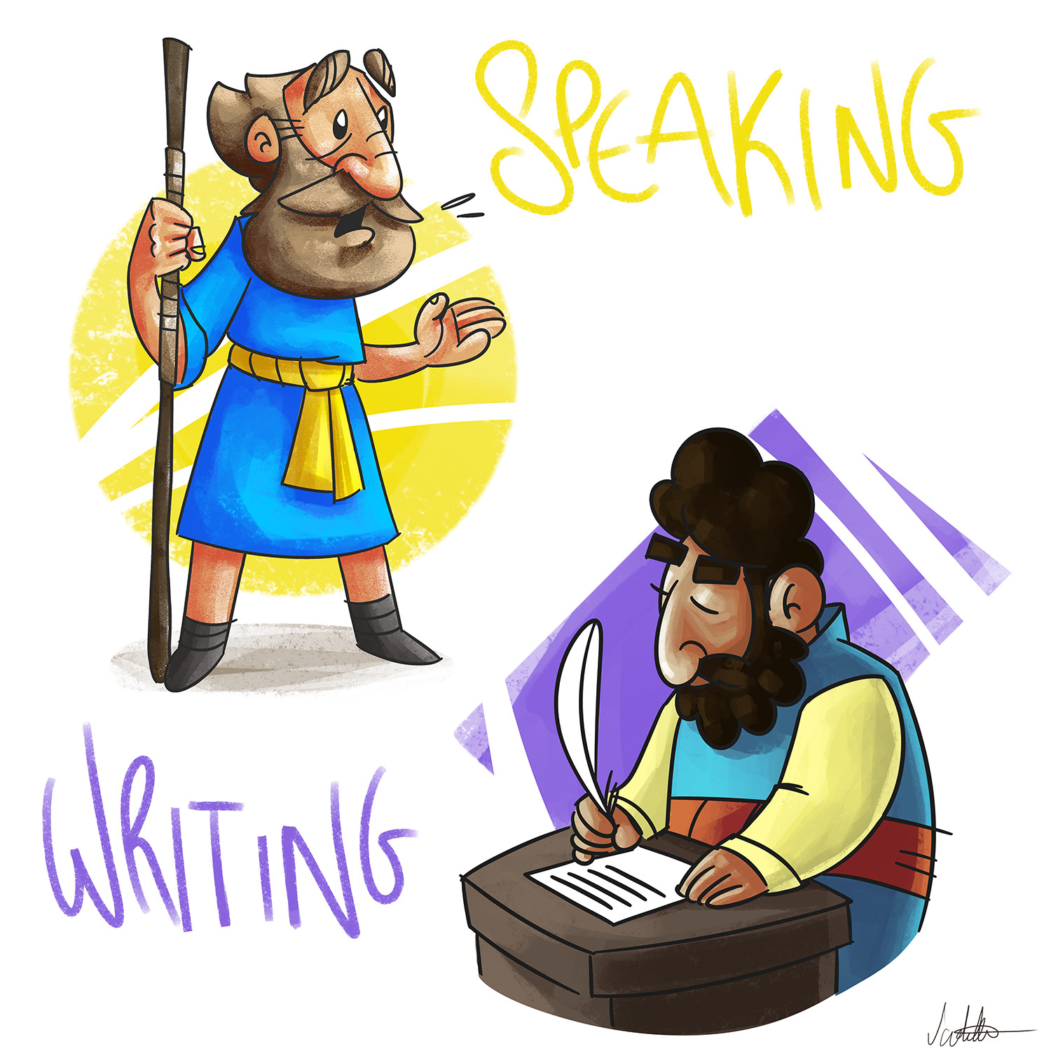
Prophetic Literature
Literature written about prophets
AND
Literature written by prophets
The Former Prophets are equally important in discussions about prophets

Slide 4
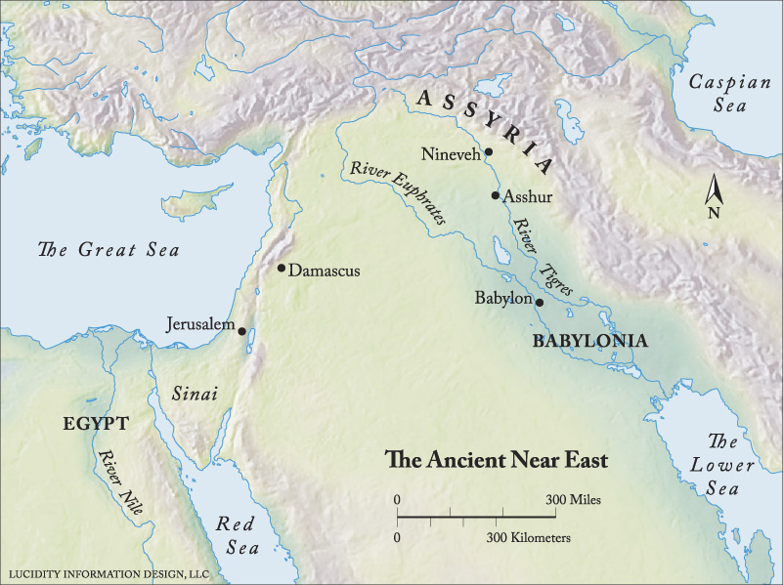
Important Places
Superpowers in the Ancient Near East
Egypt
Assyria (Northern Mesopotamia)
Babylonia (Southern Mesopotamia)
Israel was caught in the middle
Warring superpowers
Israel’s goods (Olives/Grapes) attracted attention of powerful nations

Slide 5
Two Crisis Periods
722 – Fall of Samaria
The Assyrians took Samaria
Some were exiled to Persia, some escaped to Judah
587 – Fall of Jerusalem
The Babylonians destroy Jerusalem and the temple.
The beginning of the Babylonian Exile

Slide 6
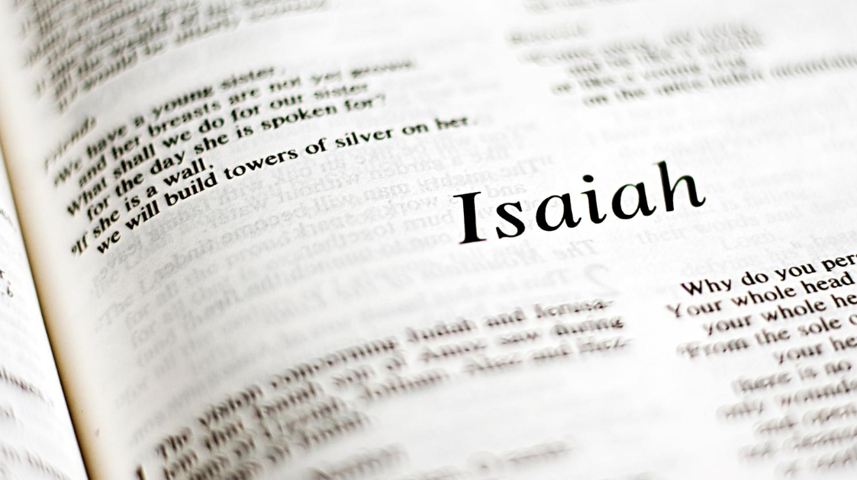
What is a prophet?
Common Modern Understandings
Someone who predicts the future
Someone who predicted Christ

Slide 7
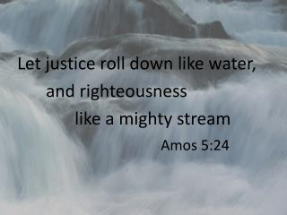
Old Testament Prophets
Concerned with the present time
Charged with a task:
Incite Change
Call out injustice
Offer hope to the suffering

Slide 8
Pre-Exilic Prophets
Prophesied before the fall of Jerusalem
Former Prophets
8th century prophets: Hosea, Amos, Micah, Zephaniah, Isaiah of Jerusalem (Is 1-39)
7th Century: Nahum
Pre-Exilic Prophecy
Prophecy of Judgement
Calling people back to YHWH

Slide 9
Post Exilic Prophets
Prophesied after fall of Jerusalem
2nd and 3rd Isaiah, Jeremiah, Ezekiel
Joel, Jonah, Obadaiah, Zechariah, Habbakuk, Haggai, and Malachi
Post Exilic Prophecy
Greater focus on restoration (traces of judgement)
Shift towards hope

Slide 10
Prophets and the Monarchy
Prophets often connected to kings
Anointed kings
Advised kings
Condemned kings
Check and Balance to the king’s power
Later prophets will criticize wealthy classes

Slide 11
Nathan and 2 Sam 11-12
Court Prophet
Connected to King David
Proclaims God’s promise to David (2 Sam 7)
Condemns David (2 Sam 12)
-Uses a parable
-Nathan successful in correcting David

Slide 12
Elijah and 1 Kgs 21
Prophet on the Periphery
Connected to Ahab (and Jezebel)
Condemns Ahab 1 Kgs 21
Direct style – no parable or other rhetoric
Elijah successful in this case

Slide 13
Prophets and Royal Women
Nathan and Bathsheba - 1 Kgs 1
Seeks help from Bathsheba, David’s wife
David is about to break an oath he made by YHWH
Together they keep David loyal to YHWH
Elijah and Jezebel - 1 Kgs 18 &19
Fraught relationship
Impedes Elijah’s work
Elijah less successful in his task

Slide 14
What can we learn from this?
1) Prophets have a single task
2)Variety in prophetic style
3) Being a prophet is for life and it is a difficult life
4) Prophets need help – they need human participation
5) It is a worthwhile call

Slide 15
Messengers of Hope
Hope is vital part of a prophet’s message
All written prophets end some hopeful vision for the future
Survival literature
Intended for communities who have experienced:
War
Exile
Severe losses of important cultural institutions
Truth telling and visions of hope are necessary for healing

Slide 16
Isaiah
1st Isaiah (700BCE): 1-39
Indictment
Assyria is a means of discipline.
Israel is going to suffer for their lack of holiness, justice, and morality
2nd Isaiah (530BCE): 40-55
Exile not punishment for sins
Serving as a light to other nations
Suffering Servant representation of the faithful Jews in exile
3rd Isaiah (475BCE): 56-66
Exiles returned from Babylonia
Oracles of salvation
Restoration

Slide 17
Isaiah in Christian Tradition
Why so important?
1) Messianic Oracles
2) Suffering Servant (48-55)
3) Hope
4) It influences the Gospel of Luke

Slide 18
Isaiah in the Gospel of Luke
Jesus’ first public words are from Isaiah 61:1-2
Proclaims Jubilee Year
Restoration
Positive anthropology

Slide 19
Elijah and Jesus
Christ presented most like a prophet in Luke
Specifically as Elijah
Elijah in 1 Kgs
Connected to Ahab (and Jezebel)
Fantastic deeds
Raising the dead, raining down fire from heaven
Christ as Elijah in Luke
Compares his mission to Elijah’s (4:20)
Raises widow’s son (7:11-17) and Elijah 1 Kgs 17:18-24
Call of disciples (9:57-62) and Elijah 1 Kgs 19:19-21

Slide 20
Focus on the Present
Emphasis on the word “today”
Realized Eschatology
Forthtelling
Jesus condemning his contemporaries
Like the prophets, he focuses his condemnation on ruling classes

Slide 21
Influence of Isaiah
Elijah
Deuteronomistic perspective
Strong negative anthropology
Focus on sin
Elijah’s condemnations are final – no vision of hope
Jesus
Presentation influenced by Isaiah, especially 3rd Isaiah
Positive
Condemns clearly, but points toward positive change

Slide 22
Conclusions
Many ways to be a prophet
Working in a system to change from inside
Working outside a system to create pressure for change
Differences in styles and approaches
Messengers of truth and hope
Both are necessary for change and healing the world

