Slide 1
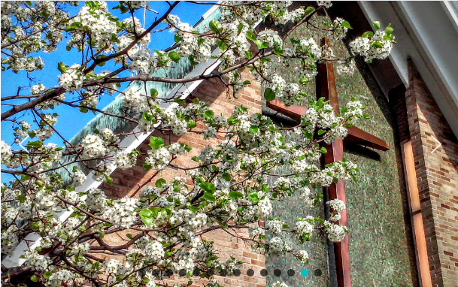
St. Paul of the Cross Retreat and Conference Center
New Board Members Orientation
Notes:
<CLICK>

Slide 2
Agenda
Welcome & Opening Prayer
History of the Board
New Board Member’s Binder
Board Calendar
Operating Budget
Assignment of Mentors
Closing Prayer
Notes:
TOBY … Welcome …
I’ll handle the Opening and Closing Prayers
John Bodary, Chair of the Board Affairs Committee will cover the History of the Board
Roger Frank and Jim McKelvey, members of the Board Affairs Committee, will cover the New Board Member’s Binder
Cindy La Fond, our Vice Chair of the Board, will cover the Board Calendar
Greg Soule, our Treasurer of the Board, will cover our Operating Budget, and
Kari Klinski, the Secretary of the Board, will cover the assignment of Mentors
<CLICK>

Slide 3
Opening Prayer
PRAYER OF THANKSGIVING
Lord God, I thank you for the great gift of your Passion, Death, and Resurrection. Thank you for listening to my prayers, for seeing into my heart, for loving me when I feared I was alone. Thank you for the gift of faith, for the Church and Sacraments, and for all those people you put into my life to help and love me. I have been blessed by you, and I am grateful. Amen.
Notes:
TOBY – PRAYER OF THANKSGIVING
Lord God, I thank you for the great gift of your Passion, Death, and Resurrection. Thank you for listening to my prayers, for seeing into my heart, for loving me when I feared I was alone. Thank you for the gift of faith, for the Church and Sacraments, and for all those people you put into my life to help and love me. I have been blessed by you, and I am grateful. Amen.
<CLICK>

Slide 4
History of the Board
1994 - Formation of an advisory board
Eight Retreatants were selected by Fr. Mike Higgins
Notes:
JOHN …
<CLICK>

Slide 5
History of the Board
2003 - Transition to a legal Board
The initial By-Laws were drafted
A Finance Committee was formed
A “Legal Incorporation Task Group” was formed
A Membership Committee was formed
Notes:
JOHN …
2003 – Preparations began under Fr. Jim Thoman for the transition from being an advisory board to a permanent legal board. During this time period the following took place:
The initial By-Laws were drafted
A Finance Committee was formed
A “Legal Incorporation Task Group” was formed to identify the steps necessary for legal incorporation by July 1, 2004
A Membership Committee was formed to establish how board membership would be handled once the legal board was established
<CLICK>

Slide 6
History of the Board
2004 – Formation of the Legal Board
Executive Committee
Building and Grounds Committee
Captains Committee
Communications and Outreach Committee
Development Committee
Formation Committee
Youth and Young Adult Committee
Notes:
JOHN …
2004 – Formation of the “legal” Board of Directors under Fr. Jim Thoman took place on July 1st and the following committees were established:
Executive Committee (Chair, Vice Chair, Secretary, Treasurer, and the Retreat Director)
Building and Grounds Committee
Captains Committee
Communications and Outreach Committee
Development Committee (Capital Campaign committee)
Formation Committee (Charism committee)
Youth and Young Adult Committee
<CLICK>

Slide 7
History of the Board
2007- A Mission Statement and the Board Policy Manual (Handbook) were adopted and the following committees were formed:
Institutional Leadership Committee
Marketing Committee
Notes:
JOHN …
2007- A Mission Statement and the Board Policy Manual (Handbook) were adopted and the following committees were formed:
Institutional Leadership Committee (Succession planning for the board, staff and the Retreat Director as well as strategic planning)
Marketing Committee
<CLICK>

Slide 8
History of the Board
2011 - The Mission Statement was revised and the Values and Vision provisions were added
Notes:
JOHN …
<CLICK>

Slide 9
History of the Board
2013 - Adoption of the Consent Agenda and the renaming of the Membership Committee to the Governance Committee
Notes:
JOHN …
2013 - Adoption of the Consent Agenda and the renaming of the Membership Committee to the Governance Committee which will focus on the five key (critical) areas for effective governance (Purpose, Education, Architecture, Results, and Leadership)
<CLICK>

Slide 10
History of the Board
2017 – The introduction of Policy Governance and the establishment of the following board committees:
Audit/Financial
Board Affairs (formerly Governance)
Charism
Ends
Policy Governance (Ad Hoc)
Notes:
JOHN …
2017 – Introduction of Policy Governance and the establishment of the five committees …
The Audit/Financial Committee is to ensure the financial stability of the ministries of St. Paul of the Cross Passionist Retreat Center (SPC) and safeguard its assets.
The Board Affairs Committee is to oversee the internal business of the Board in accordance with its Articles of Incorporation, Bylaws and Governance policies; to plan ongoing Board education; and obtain qualified members for the Board and its Committees.
The Charism Committee is to ensure the Passionist Charism (in the Spirit of St. Paul of the Cross) is an integral part of each board of directors meeting.
The Ends Committee is to articulate not what the organization does, but why it exists, for what people, and at what cost.
The Ad Hoc Policy Governance Committee was created to assist in the adoption of the Policy Governance model.
<CLICK>

Slide 11
New Board Member’s Binder
Mission, Guiding Values, & Vision
Spirit of the Passionist Retreat Center
The By-laws
Board of Directors Policy Handbook
Board of Directors Contact Info
Board of Directors Service Matrix
Organizational Overview
Board Committees
Notes:
ROGER …
The heading for this section is a bit misleading since we no longer provide our new board members with a binder … tomorrow you’ll receive all these document electronically.
We’ll now briefly cover each one of these items … <CLICK>

Slide 12
New Board Member’s Binder
MISSION STATEMENT
“In the Spirit of St. Paul of the Cross and through the love of Christ crucified, we provide a unique, sacred place of hospitality and compassion where all are welcome to experience hope, renewal, and the loving presence of God through spiritual retreats and hosted events.”
Notes:
ROGER …
Read …
<CLICK>

Slide 13
New Board Member’s Binder
GUIDING VALUES
Christ Centered Spirituality
Compassion
Hospitality
Quiet & Prayerful Environment
Service to All
Notes:
ROGER …
The following are the Guiding Values of St. Paul of the Cross Retreat and Conference Center:
Christ Centered Spirituality: Finding hope and strength in the midst of suffering through the passion of Christ.
Compassion: Experiencing in a down to earth way God’s tender mercy.
Hospitality: A profound acceptance and open-hearted welcome of all who come to St. Paul of the Cross.
Quiet & Prayerful Environment: Offering a comfortable and a nurturing place of safety that prepares the human heart for contact with God.
Service to All: Discovering and meeting the pressing unmet needs found in both the church and humanity.
<CLICK>

Slide 14
New Board Member’s Binder
VISION STATEMENT
We are a dynamic, growing retreat and conference center serving people from all walks of life primarily in the greater Detroit area. Our core ministry consists of our preached weekend retreats and evening and daytime Passionist programs. The retreat experience is having a positive impact on the lives of others which benefits families and our communities.
Notes:
ROGER …
Read …
<CLICK>

Slide 15
New Board Member’s Binder
This 52-page Document Identifies the Characteristics of Passionist Retreat Centers
Notes:
ROGER …
In May of 2000, the Province Retreat Center Board began a major initiative to develop new structures of governance capable of carrying forward the mission of Holy Cross Province retreat centers. These new institutional developments would respond to the challenges posed by significant, long-term reductions in vowed Passionist personnel. To respond well, the new agencies would need a faithful possession of the Passionist spirit or charism that is the driving force of retreat center ministry. It was for these reasons this document was developed.
<CLICK>

Slide 16
New Board Member’s Binder
The Bylaws
Article I – Corporation
Article II – Board of Trustees
Article III – Meeting of the Trustees
Article IV – Board of Directors
Article V – Meetings of Directors
Article VI – Officers of the Corporation
Article VII – Committees of the Board
Article VIII – Miscellaneous Provisions
Notes:
ROGER … The Bylaws …
This is a 14-page document which identifies the Corporation and the roles and duties of the Board of Trustees, the Board of Directors, Officers of the Corporation and its Committees.
It also contains a Miscellaneous Section with provisions regarding the Indemnification of the Trustees, Board, and Officers as well as policies dealing with conflicts of interest, acceptance of gifts, whistle blower protection, corporation minutes and records, and the like.
<CLICK>

Slide 17
Key Provisions of the Bylaws
Directors Pledge to:
Fulfill the Passionist Mission
Abide by the Articles of Incorporation & Bylaws
Promote the Roman Catholic nature
Promote the Sponsorship of Holy Cross Province
Adopt the policies of Holy Cross Province
Maintain correct/complete books & records
Comply with Michigan Nonprofit Corporation Act
Notes:
ROGER …
One key provision of the Bylaws requires a pledge on the part of the Directors to:
Fulfill the Passionist Mission
Abide by the Articles of Incorporation & Bylaws
Promote the Roman Catholic nature
Promote the Sponsorship of Holy Cross Province
Adopt the policies of Holy Cross Province
Maintain correct/complete books & records
Comply with Michigan Nonprofit Corporation Act
<CLICK>

Slide 18
Key Provisions of the Bylaws
Responsibilities:
Determine the Mission and Policies
Recruit and evaluate candidates for the position of Director of Mission and Ministry
Assess the Performance of the Director
Propose amendments to the Bylaws
Safeguard the Corporation’s assets
Notes:
ROGER …
Another key provision of the Bylaws states the specific responsibilities of the Board of Directors. We are to:
Determine the Mission and Policies,
Recruit and evaluate candidates for the position of Director of Mission and Ministry (yes, we have the authority to hire and fire),
Assess the Performance of the Director (we do by monitoring his/her progress throughout the year at each board meeting),
Propose amendments to the Bylaws (when required), and
Safeguard the Corporation’s assets.
<CLICK>

Slide 19
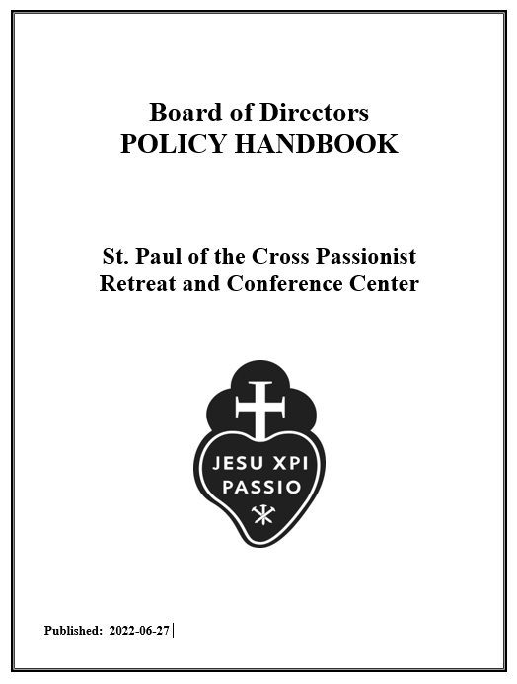
New Board Member’s Binder
Board of Directors Policy Handbook
Notes:
JIM …
This is a 23-page document which contains the policies germane to the Board of Directors.
<CLICK>

Slide 20
New Board Member’s Binder
Board of Directors Policy Handbook
Mission Statement/Guiding Values/Charism
Organization
Overview
Global Governance Commitment
Governing Style
Glossary of Terms
Policies
Notes:
JIM …
Key sections of the Handbook include:
The Mission Statement/Guiding Values/Charism statements (two of which you’ve already seen)
A graphic of the organization structure (which you will see in a few minutes)
An Overview statement about the Board adopting the Policy Governance Model
The Global Governance Commitment regarding the Board’s responsibility to achieve the corporation’s End’s Policies and operate according the Bylaws
Governing Style which is to be an outward vision, a diversity of viewpoints, and collective.
A Glossary of commonly used terms in the Handbook, and
The four policies required for governance
We’ll take a brief look at the sections which have not already been covered
<CLICK>

Slide 21
Key Provisions of the Handbook
Overview:
Adopted the Policy Governance® Model
Govern on behalf of the Owners
Develop a Vision in line with the Mission
Ensure the Retreat Center achieves what it should and avoid what is unacceptable
Notes:
JIM …
As previously noted, the Board adopted the Policy Governance Model in 2017 and we govern St. Paul of the Cross Retreat Center on behalf of the owners which is Holy Cross Province.
We are charged with looking forward and developing a vision in line with the Mission and we are to ensure the Retreat Center achieves what it should and avoid what is unacceptable. It’s really that simple.
<CLICK>

Slide 22
Key Provisions of the Handbook
Governing Style:
Outward vision
Encouragement of diversity in viewpoints
Collective rather than individual decisions
Clear distinction of Board and CEO/Management roles
Notes:
JIM …
Our Governing Style should have an emphasis on Outward Vision … i.e., what should St. Paul of the Cross “look” like in 5 years, 10 years, 25 years …
Accordingly, we must encourage each other to speak their minds and we function as a “collective” rather than as individuals when reaching decisions. There is a clear distinction of our role as a board – “it’s to be arms around, not fingers in”.
The Board’s major focus should be on the intended long-term impacts outside the organization, not on the administrative or means of attaining those impacts.
<CLICK>

Slide 23
Key Provisions of the Handbook
Policies:
Ends Policies – What’s Expected
Governance Policies – How the Board is to operate; its responsibilities, duties, & expectations
Executive Limitation Policies – Limitations on the Director of Mission and Ministry
Board Executive Linkage Policies – Relationship between the Board and the Director
Notes:
JIM … Policies: These are the policies listed in the handbook <CLICK>
There are 6 Ends Policies against which the Director of Mission and Ministry is evaluated. <CLICK>
There are 15 Governance Policies which are in place to guide the Board in their work. <CLICK>
There are 12 Executive Limitation Policies which gives the Director of Mission and Ministry latitude to perform his or her duties unless otherwise limited by any of these policies. <CLICK>
There are 5 Board Executive Linkage Policies which states that the board’s connection to the operation of the retreat center will only be through the Director of Mission and Ministry. The last of the 5 policies describes the monitoring of the Director of Mission and Ministry's performance.
Finally, there is also an Addendum which contains the guidelines governing the Board’s committees – their Purpose; Scope of Authority, Power, and Responsibility; Rules of Governance, and Membership.
<CLICK>

Slide 24
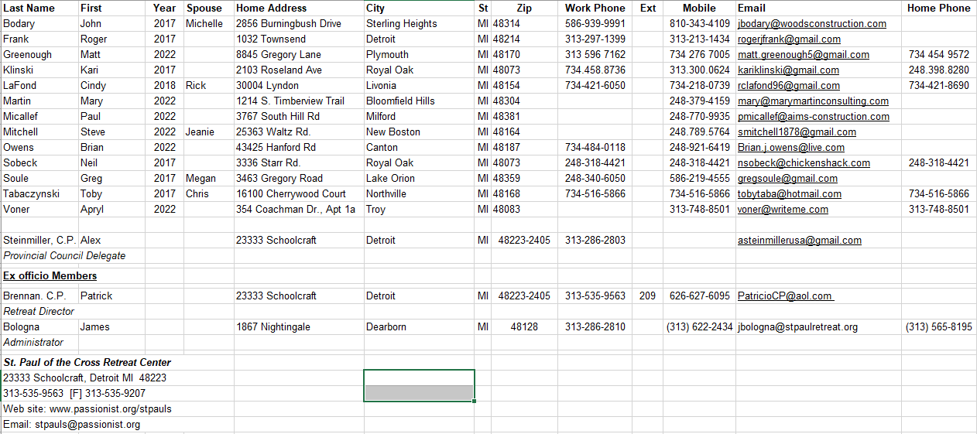
New Board Member’s Binder
Board of Directors Contact Information
Notes:
JIM …
Once you receive this document, please let John Bodary, Chair of the Board Affairs committee, know of any additions or corrections to your information and then we’ll redistribute the document.
<CLICK>

Slide 25
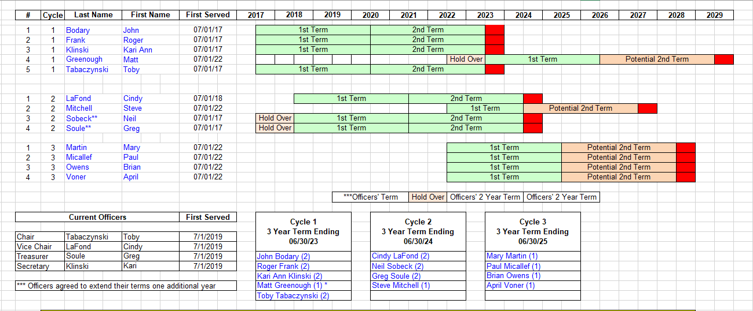
New Board Member’s Binder
Board of Directors Service Matrix
Notes:
JIM …
One of the roles of the Board Affairs committee is to manage the selection of board members in such a way to minimize having a large number of members rotate off the board at the same time. As you may know, each board members is selected for a three-year term with the possibility of serving a second three-year term. There are guidelines in the Bylaws for filling out unfinished terms of board members who resign.
Four of you – <CLICK> Mary, Paul, Brian, and Apryl have been assigned (by drawing your names from a hat) to Cycle 3 and you will begin serving your first of potentially 2 terms of 3-years each effective July 1, 2022.
Matt Greenough’s name was drawn to fill out the last year of the term of a board member who resigned in Cycle 1. <CLICK> Accordingly, Matt will begin serving the first of potentially 2 terms effective, July 1, 2023. <CLICK>
Steve Mitchell’s name was drawn to fill out the remaining two years of a former board member and so he will be eligible to serve a potential 2nd 3-year term in 2024.
<CLICK>

Slide 26
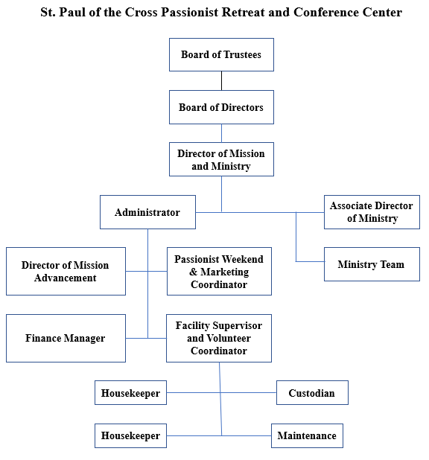
New Board Member’s Binder
Organizational Overview
Notes:
JIM …
This organization chart shows the relationship of the Board of Trustees to the Board of Directors to the Directory of Mission and Ministry.
<CLICK>

Slide 27
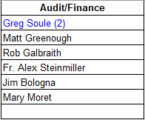
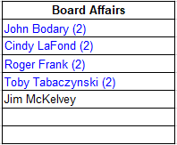
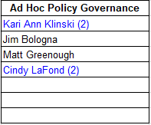
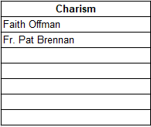
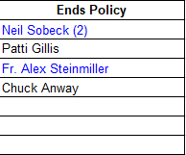
New Board Member’s Binder
4 Board Committees
Plus 1 Ad Hoc Committee
Notes:
JIM …
The board has four active committees and one ad hoc committee whose work is mostly complete. A person doesn’t have to be a board member to service on one of the board’s committees. <CLICK>
The Audit/Finance committee currently has six members <CLICK>
The Board Affairs committee currently has 5 members <CLICK>
The Charis committee currently has only 2 members, and <CLICK>
The Ends Policy committee currently has four members. <CLICK>
The Ad Hoc committee whose work is pretty much done has 4 members. <CLICK>
Committee assignments for you new board members will be made following discussions at the All-Day retreat in September.
<CLICK>

Slide 28
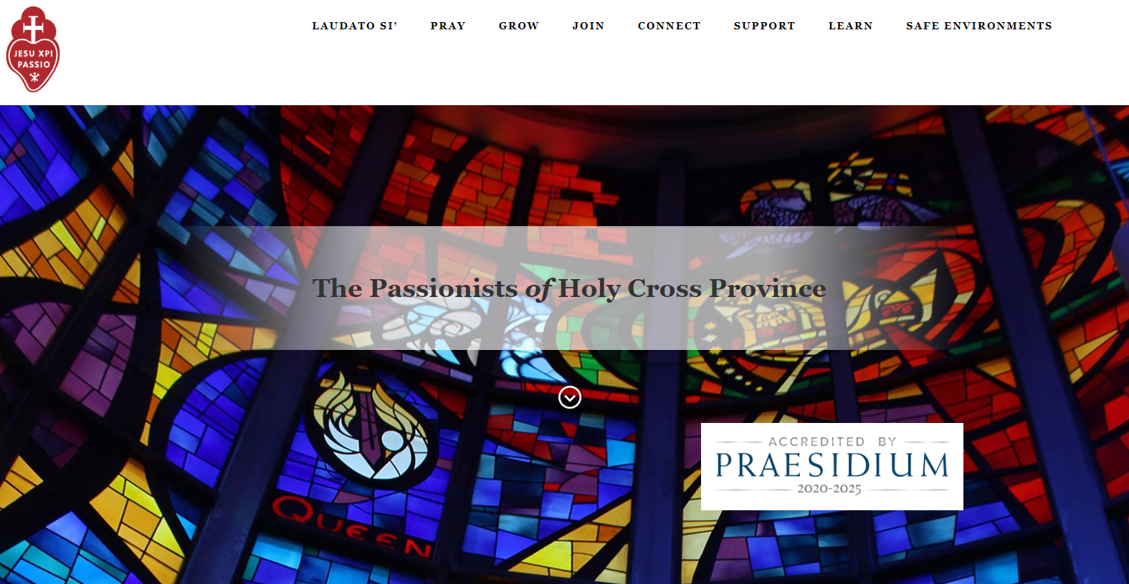
New Board Member’s Binder
St. Paul of the Cross Retreat Center Portal
https://Passionist.org
Notes:
JIM …
A number of the above referenced documents plus many others can be found on the St. Paul of the Cross Retreat Center Portal which is located in the Holy Cross Province website.
Here is the link … <CLICK>
https://Passionist.org …
In a few minutes we’ll explain where on this Portal you’ll be able to download your Board Member’s Binder
<CLICK>

Slide 29
New Board Member’s Binder
St. Paul of the Cross Retreat Center Portal
Scroll to the bottom of the page and click on the “Board Member Portal”
The password is “policygovernance”
Notes:
JIM …
When the screen refreshes, scroll to the bottom of the page and click on the “Board Member Portal” <CLICK>
The password is <CLICK> “policygovernance” with no spaces. <CLICK>

Slide 30
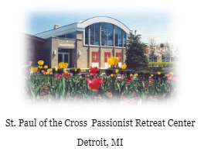
New Board Member’s Binder
St. Paul of the Cross Retreat Center Portal
Scroll to the bottom of the page and click on the picture of St. Paul of the Cross Retreat Center
Notes:
JIM …
When the screen refreshes, scroll to the bottom of the page and click on the picture of St. Paul of the Cross Retreat Center. <CLICK>
<CLICK>

Slide 31
New Board Member’s Binder
St. Paul of the Cross Retreat Center Portal
Notes:
JIM …
When the screen refreshes, you’re inside our portion of the portal which is currently being updated. Once the updating is done, here is where you’ll find most of the documents you’ll need as a board member.
The left side of the screen lists the various sections of the portal, <CLICK> in this case the Board of Directors and <CLICK> the right side shows all the content …
<CLICK>

Slide 32
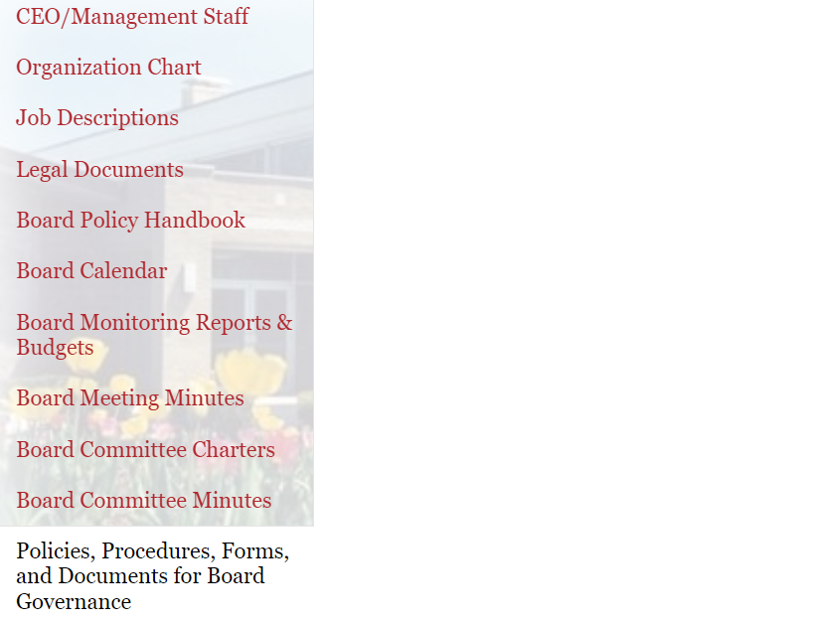
New Board Member’s Binder
St. Paul of the Cross Retreat Center Portal
Notes:
JIM …
To download the material for your Board Member’s Binder, scroll to the bottom of the list and click on “Policies, Procedures, Forms, and Documents for Board Governance.
When the screen refreshes, you’ll see the Documents section and in that section you’ll see the folder which contains your binder material.
<CLICK>

Slide 33
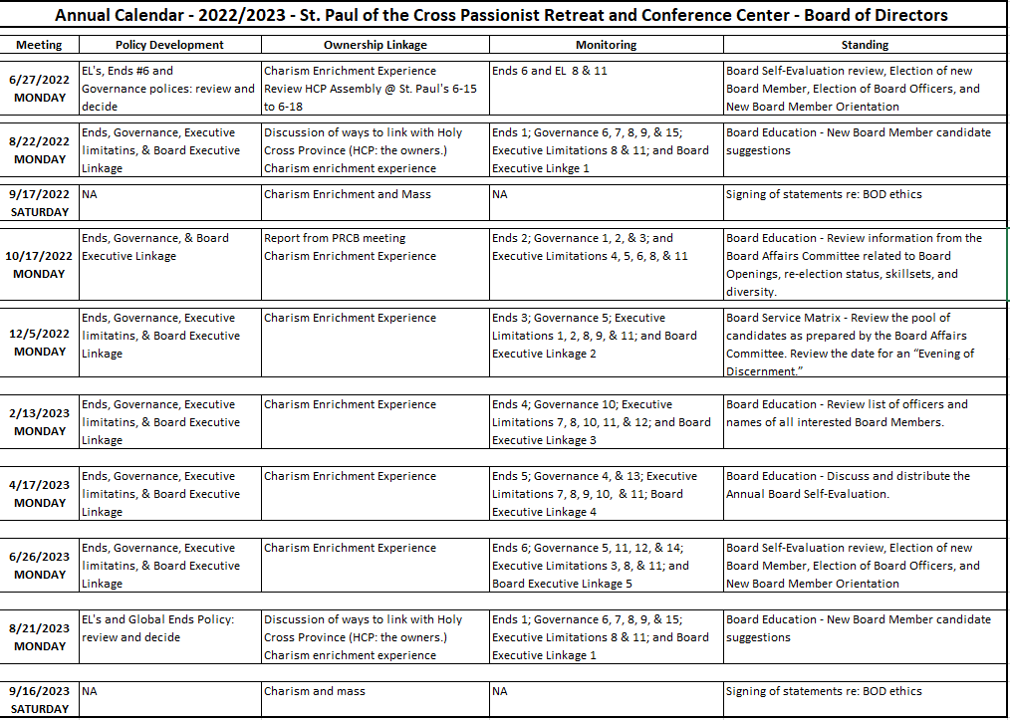
New Board Member’s Binder
The Board Calendar
Notes:
CINDY …
The calendar for the upcoming fiscal year (July 2022 through June 2023) is still being created. This is our current draft and it will give you a sense of the topics the board covers throughout the year.
We typically meet six times a year (October, December, February, April, June, and August) plus a full day in September for our All Day Retreat
Our Meeting dates are listed in the second column and the remaining columns show the Policies which will be reviewed in the meeting, the linkage to our owners, and whatever topics the standing committees will report on throughout the year.
<CLICK>

Slide 34
Financial Information
Fund Structure
Operating Fund
Fr. J. Thoman Endowment Fund
Usage of investment earnings is limited
Maintenance of capital infrastructure
Salary support for Lay Retreat Center Director
Salary support for Development Director
Cannot go underwater (spending the corpus)
$1.2MM as of 3/31/22
Gorno Endowment
Usage of investment earnings is limited – Similar to Thoman
Cannot go underwater (spending the corpus)
$240,000 as of 3/31/22
Notes:
GREG …
TBD …
<CLICK>

Slide 35
Financial Information
Assets:
Cash
Receivables – hosted events
Funds held by province (provincial pooled investment account)
Property and equipment
Liabilities:
Accounts payable
Due to Province/Community
Accrued Payroll
Deferred revenue (funds received in advance of events/retreats)
Notes:
GREG …
TBD …
<CLICK>

Slide 36
Financial Information
Sources of Revenue:
Donations – restricted and unrestricted
Restricted – donor-imposed stipulations as to usage or time
Unrestricted – includes Christmas appeal, Directors Circle,
Weekend Passionist-conducted retreats
Other retreats and programs
Meeting groups, recovery groups
Hosted programs – day and overnight
Youth/high school groups, outside groups
Gift shop
Special events (golf outing)
Notes:
GREG …
TBD …
<CLICK>

Slide 37
Financial Information
Expenditures:
Room and table – Contracted food service, laundry, supplies
Automobile
Maintenance – interior and exterior
Utilities
Wages and benefits
Printing, marketing, postage
Consultant charges
Bank and credit card fees
Fundraising expenses
Gift shop / other
Interinstitutional – contractual payments to community and province
Notes:
GREG …
TBD …
<CLICK>

Slide 38
Financial Information
2023 Budget – Revenue
Contribution revenue - $524,000
Retreat Revenue - $428,000
Hosted Programs – Day and Overnight - $408,000
Other Revenue - $31,000
Interest and Investment Earnings - $63,000
Total Budgeted Revenue - $1,454,000
Notes:
GREG …
TBD …
<CLICK>

Slide 39
Financial Information
2023 Budget – Expenses
Room and Table - $304,000
Automobile and Travel - $12,000
Maintenance - $55,000
Utilities - $134,000
Wages and Benefits - $581,000
Administrative Expenses - $127,000
Other, Special Events, Gift Shop - $68,000
Interinstitutional - $129,000
Total Budgeted Expenses - $1,410,000
Notes:
GREG …
TBD …
<CLICK>

Slide 40
Assignment of Mentors
Mentee | Mentor
Matt Greenough | Toby Tabaczynski
Mary Martin | Kari Klinski
Paul Micallef | John Bodary
Deacon Steve Mitchell | Greg Soule
Brian Owens | Neil Sobeck
Apryl Voner | Cindy La Fond
Notes:
KARI …
The guidelines for the relationship between mentors and their mentees can be found on pages 9 and 10 of your Policy Handbook. In short, the relationship …
Is temporary – approximately 12 months
Meet or talk as needed
Mentors are to help mentees understand issues relating to their duties and responsibilities
<CLICK>
The Board Affairs Committee has made the following assignments … READ THEM …
<CLICK>

Slide 41
Thank you and Closing Prayer
Notes:
TOBY … TBD
<CLICK>

